Slide 1
NLAIFGML
(Natural Language to AI Face-Generation using Machine Learning)
Authors: Abel, Beyza, Edward, Ryan

Slide 2
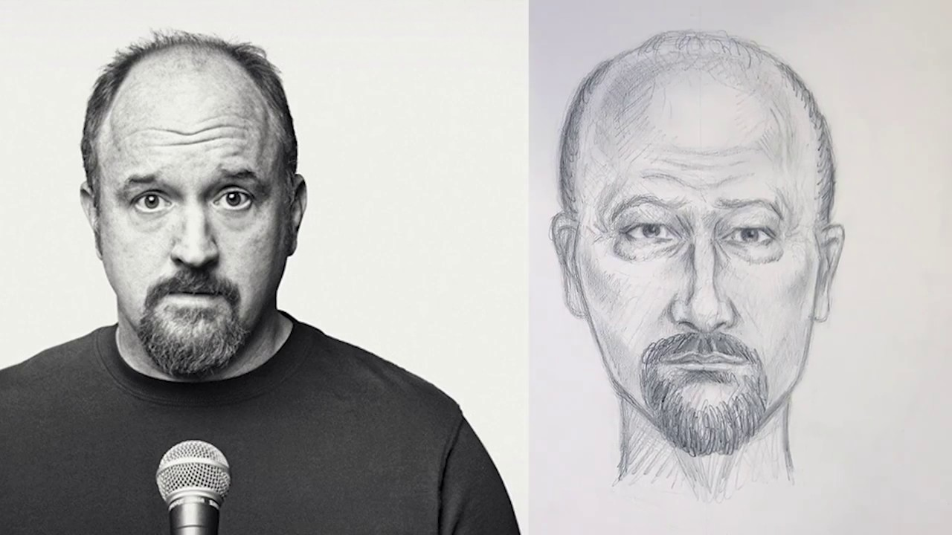
The Overview
Crime is a fact of society
What will we do?
Who will use it?

Slide 3
The Purpose
Help Federal and Local law enforcement
Increase criminal identification by 20%
How will we measure results?

Slide 4
The Work
The utilization of AI technology to help agencies identify criminals
Sketches
Word of mouth
Social profiles
Cloud-based infrastructure
Modern forensics
Doesn’t this already exist? Yes, but let’s make it better…

Slide 5

The Product
A desktop-class application packaged with everything out of the box!
Basic functionality
Input common facial descriptors via Natural Language
Create (or strengthen) an image of a sketch
Generate 3D human facial model
Extensibility
Database connectivity
Real-time data gathering
Cloud environment

Slide 6

Mandated Constraints

Slide 7

Solution Constraints, Environment, Collaborative Software
Solution Must-Haves:
Natural-Language Processor
Access to Public Security Camera Images/Footage
Ability to Produce an Original, Human-Like Face
MacOS, Linux, Windows
Collaborate with Public Security Database Systems
Software will be sold privately to Crime Investigation Agencies

Slide 8

Workplace Environment, Scheduling, Budget Constraints
Workplace Environment Constraints
User must have the ability to speak or type
Office must have access to internet
Computer must have CPU capable to powerful AI calculations
Order of Operations:
Gain access to public security camera databases
Develop face-generation
Develop deep learning algorithms from new-incoming data
Budget Estimate:
5 years, 20 Engineers at $150k+ ≈ $15 million 😩

Slide 9
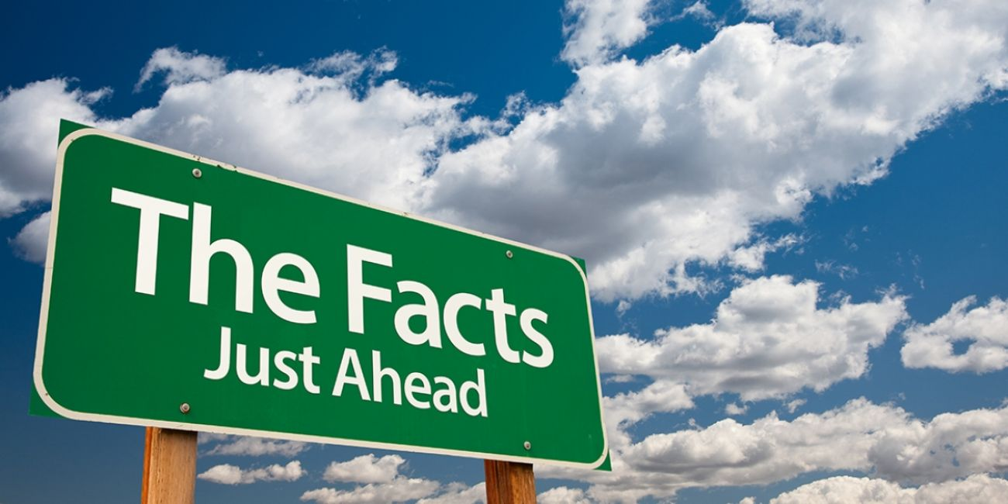
Relevant Facts & Assumptions

Slide 10
FACTS
The Natural-Language processing aspect will only support certain languages, most likely languages commonly used by crime investigators in the U.S.
At product setup time, software will immediately scan all known images in the database, initializing AI knowledge. AI will periodically scan for new images in the database.

Slide 11
ASSUMPTIONS
User’s computer will have line/internet access to the image database(s).
User’s computer is powerful enough to handle machine learning and AI generation aspects.
User speaks one of the languages included in the natural language processing aspect.

Slide 12
Stakeholders
Governments
Schools and universities
Advertising

Slide 13
References
https://www.youtube.com/watch?v=tUmHDunQcDA

